Slide 1
Reading and writing datasets
Notes:
[Mandatory Slide] This would be the introduction slide of the topic that you are covering in this subsection.
When this slide plays, you could talk about the main aim that we’d be covering in this video.

Slide 2
In this Video, we are going to take a look at…
Reading/writing datasets with Pandas
Code sample: importing and exporting datasets
Notes:
[Mandatory Slide]
Before the start of the video, we’d like to highlight what are important topics or pointers that we’d be covering in this video. This slide would immediately follow the intro/name slide. This would just be say 2-3 points for the viewers to know what they are getting into.

Slide 3
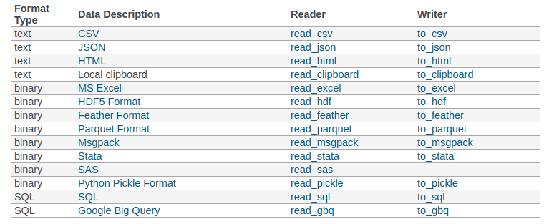
Reading/writing datasets with Pandas (1/2)
Pandas offers an incredibly wide selection of reader and writer utilities, allowing to read/write to/from a lot of file formats (eg. CSV, JSON, SQL, HDF5, …)
Input functions are library-level utilities and return Dataframe objects
Output functions can be directly invoked on Dataframe objects
Notes:
[Mandatory Slide]
Before the start of the video, we’d like to highlight what are important topics or pointers that we’d be covering in this video. This slide would immediately follow the intro/name slide. This would just be say 2-3 points for the viewers to know what they are getting into.

Slide 4

Reading/writing datasets with Pandas (2/2)
Once Pandas used to also embed readers that allowed to read data from financial web APIs (such as Yahoo! Finance, Google Finance, etc.) but they were refactored out into a separate library
This library is called pandas-datareader and can be installed as usual with:
pip install pandas-datareader
Notes:
[Mandatory Slide]
Before the start of the video, we’d like to highlight what are important topics or pointers that we’d be covering in this video. This slide would immediately follow the intro/name slide. This would just be say 2-3 points for the viewers to know what they are getting into.

Slide 5
Code Sample: importing and exporting datasets
Notes:
Something that needs to grab the viewers attention!!

Slide 6
Summary
Reading/writing datasets with Pandas
Code sample: importing and exporting datasets
Notes:
[Mandatory Slide]
Before the start of the video, we’d like to highlight what are important topics or pointers that we’d be covering in this video. This slide would immediately follow the intro/name slide. This would just be say 2-3 points for the viewers to know what they are getting into.

Slide 7
Cleaning and manipulating datasets
Next Video
Notes:
[Mandatory Slide]
Here the name of the next video needs to be mentioned. The narration as you guessed it would be just letting the viewer know exactly where we are at and what we’d be taking over next! ☺

